Slide 1
How to Convert a classic Stereograph Print to a digital Space
Using Adobe Photoshop

Slide 2
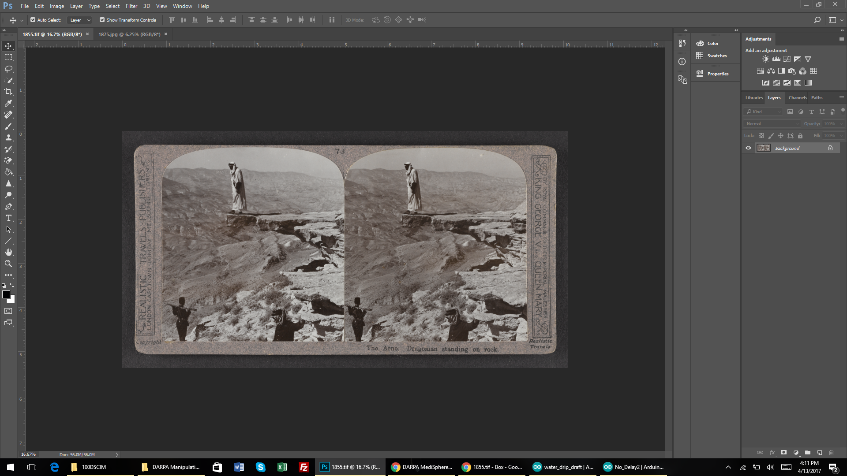
Open Scanned Stereograph Image in Photoshop

Slide 3
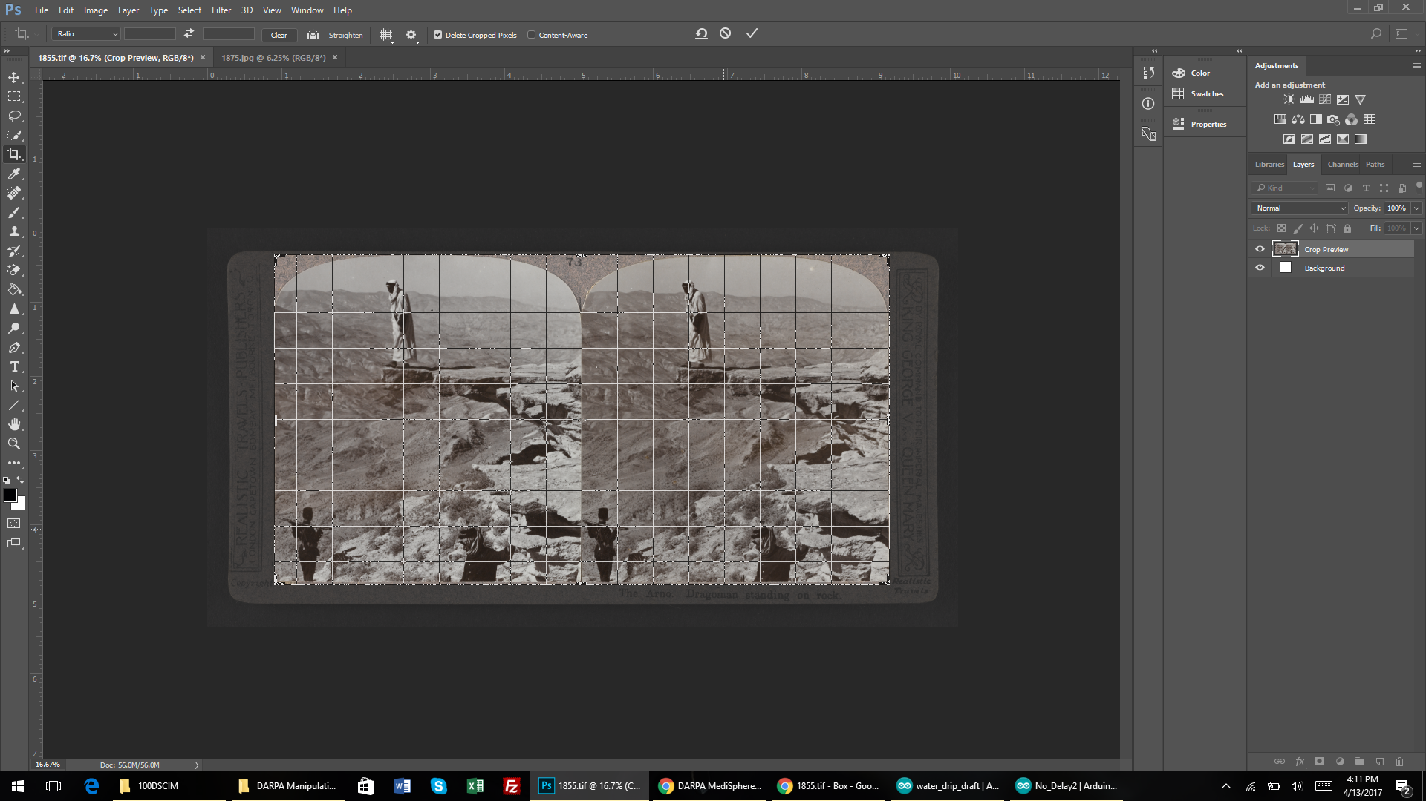
Open Crop tool and remove the boarders of the scan so only the images remain.

Slide 4
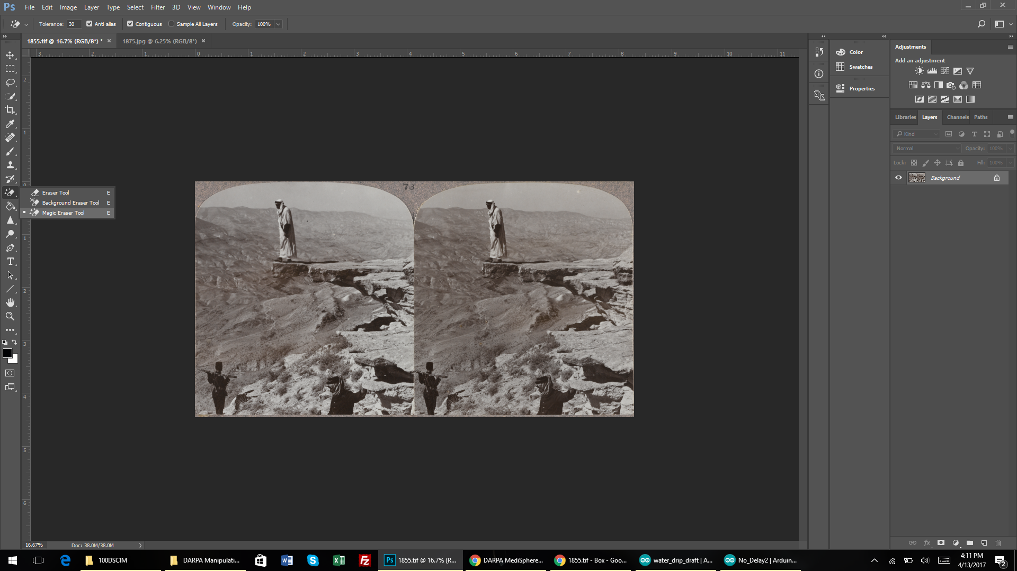
Once the background is removed use the “magic eraser tool” to remove the rest of the background still visible.

Slide 5
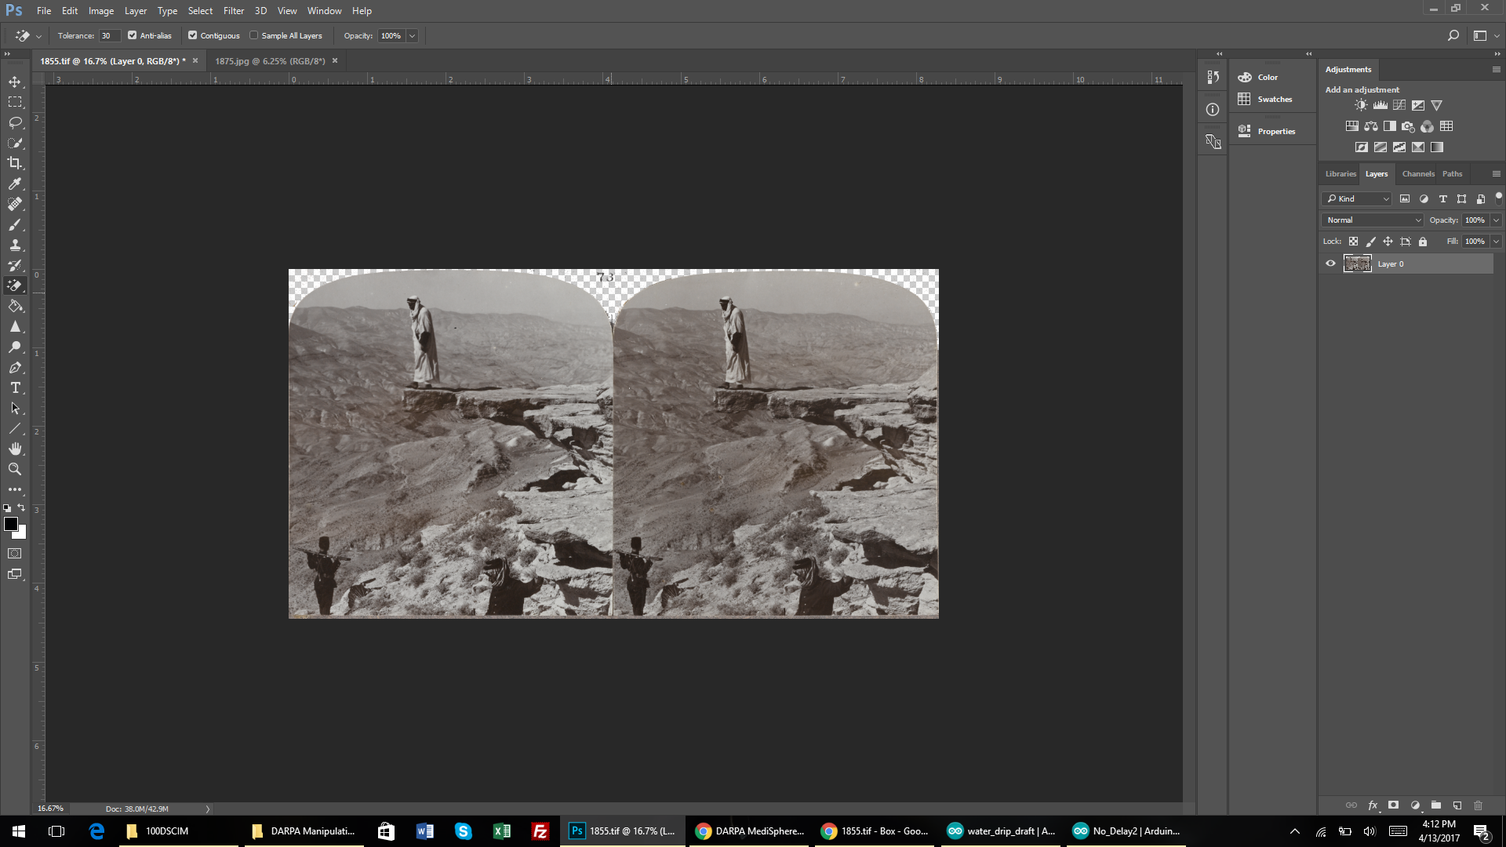
Click on the area you wish to remove

Slide 6
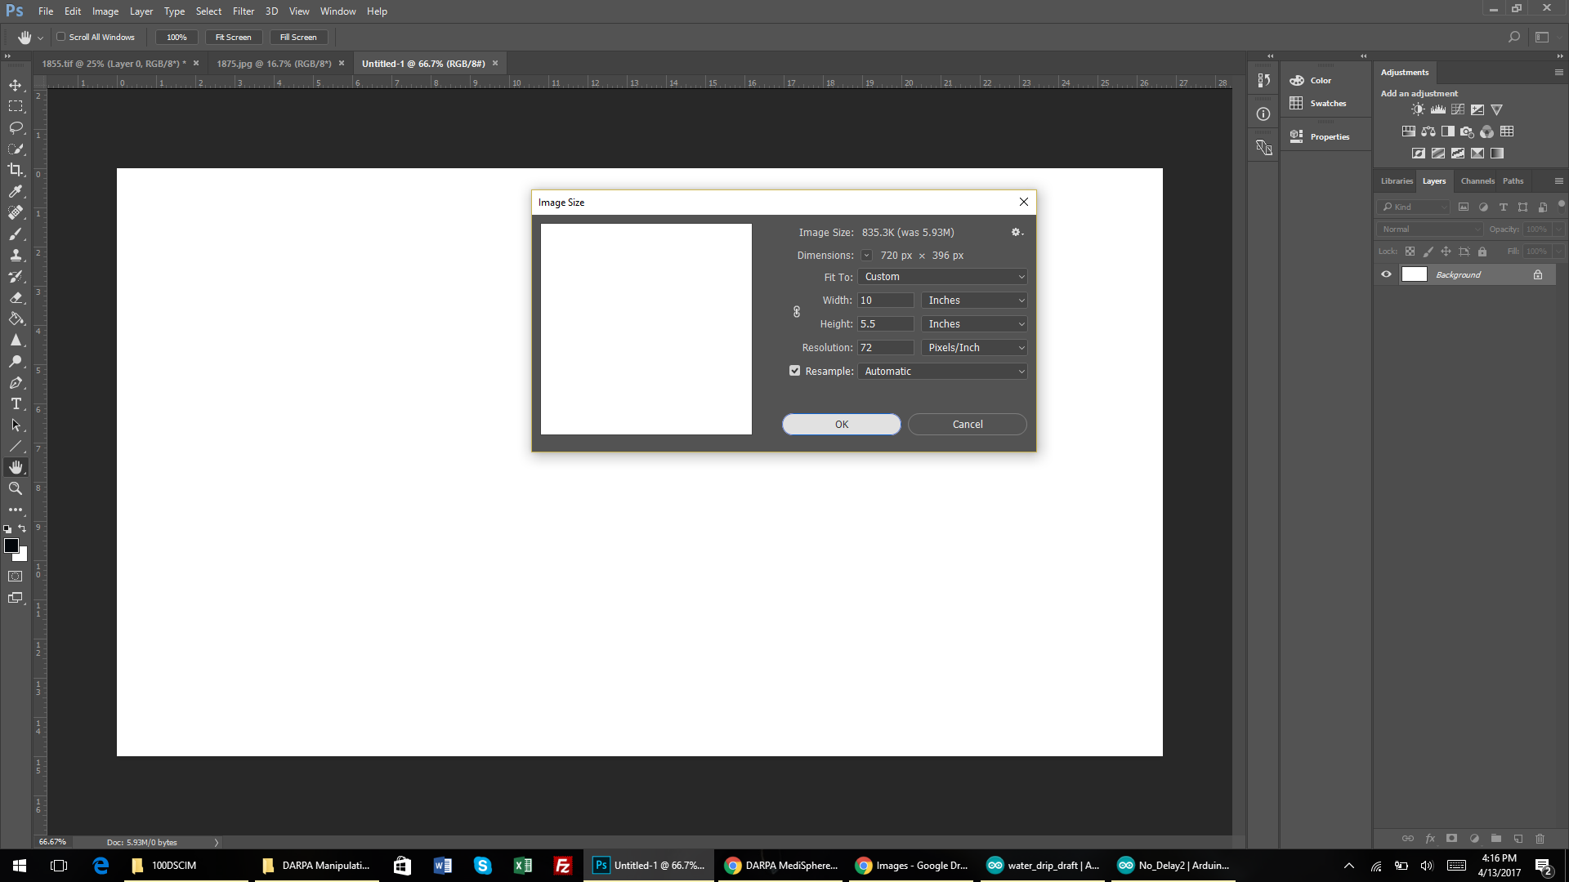
Open a new file to use as you background. If they are not being separated a size of 5.5 x 10 at 300 DPI is recommended

Slide 7
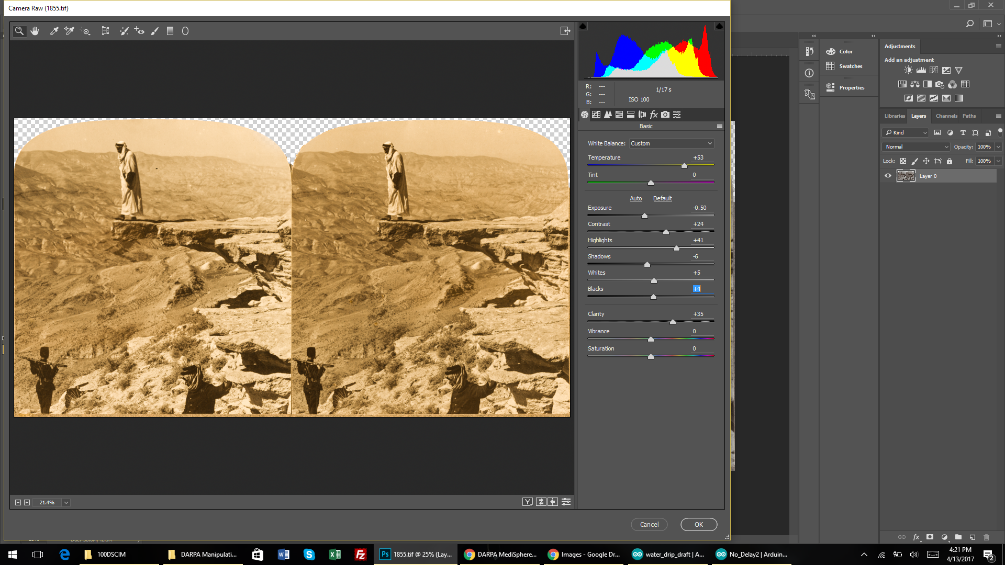
In camera raw found under the filters tab add contrast and fix colors in the image, global edits.

Slide 8
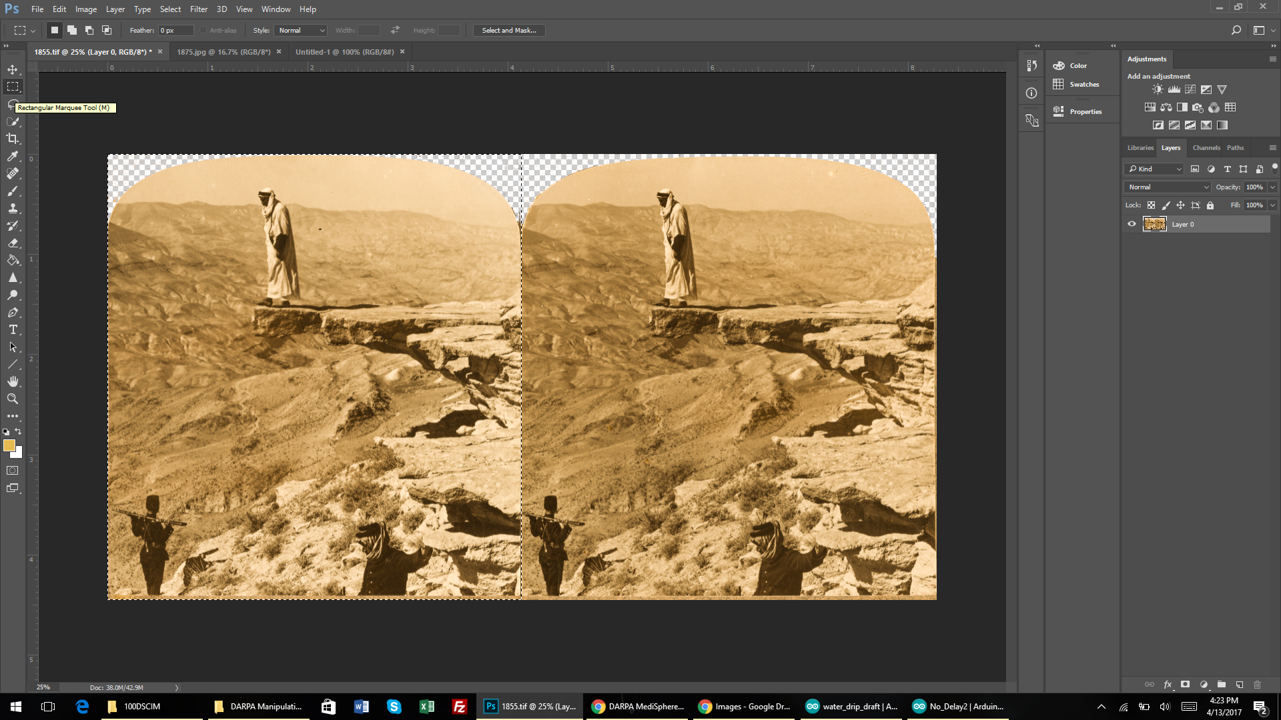
Go back to the other image and use the select tool to select one of thee images.

Slide 9
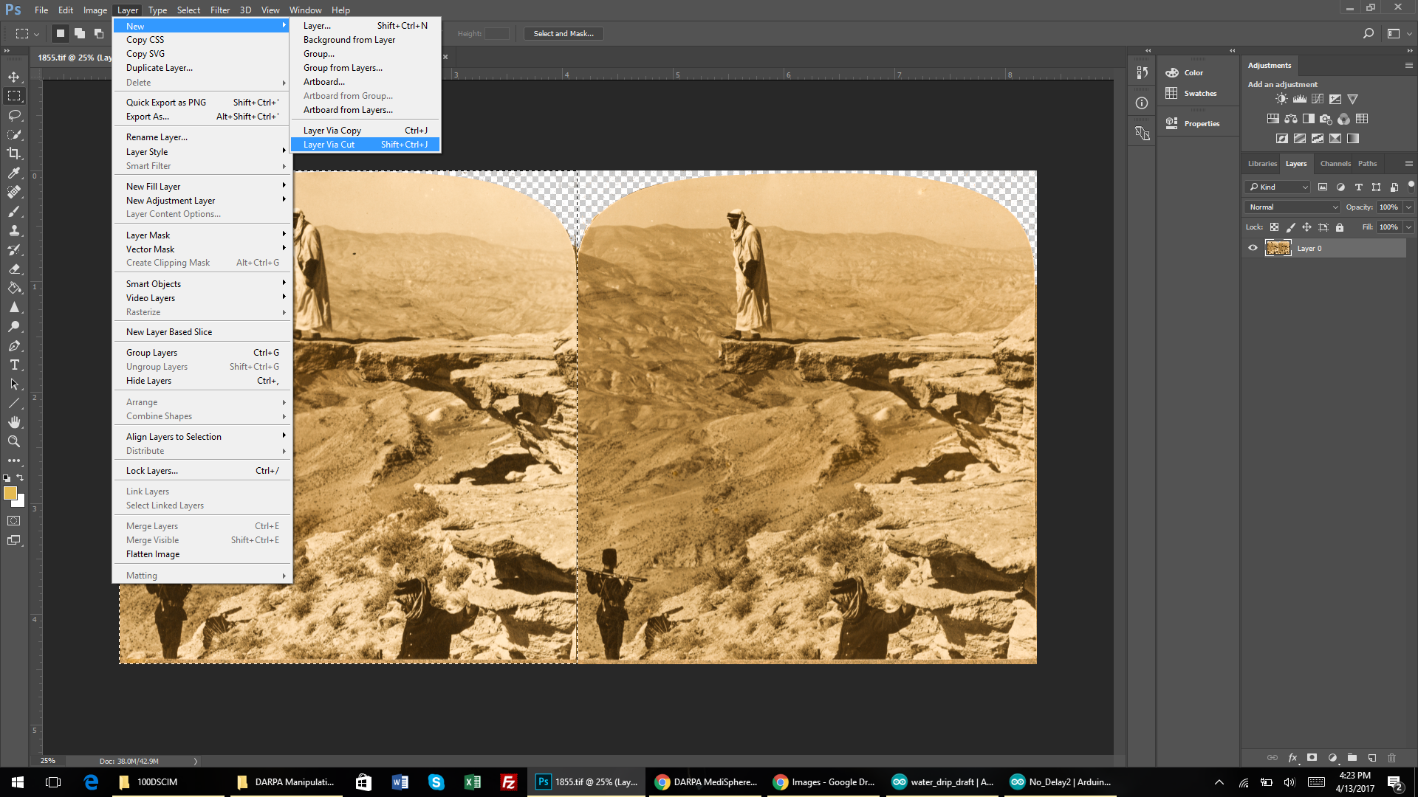
Cut out the image so it is its own selection

Slide 10
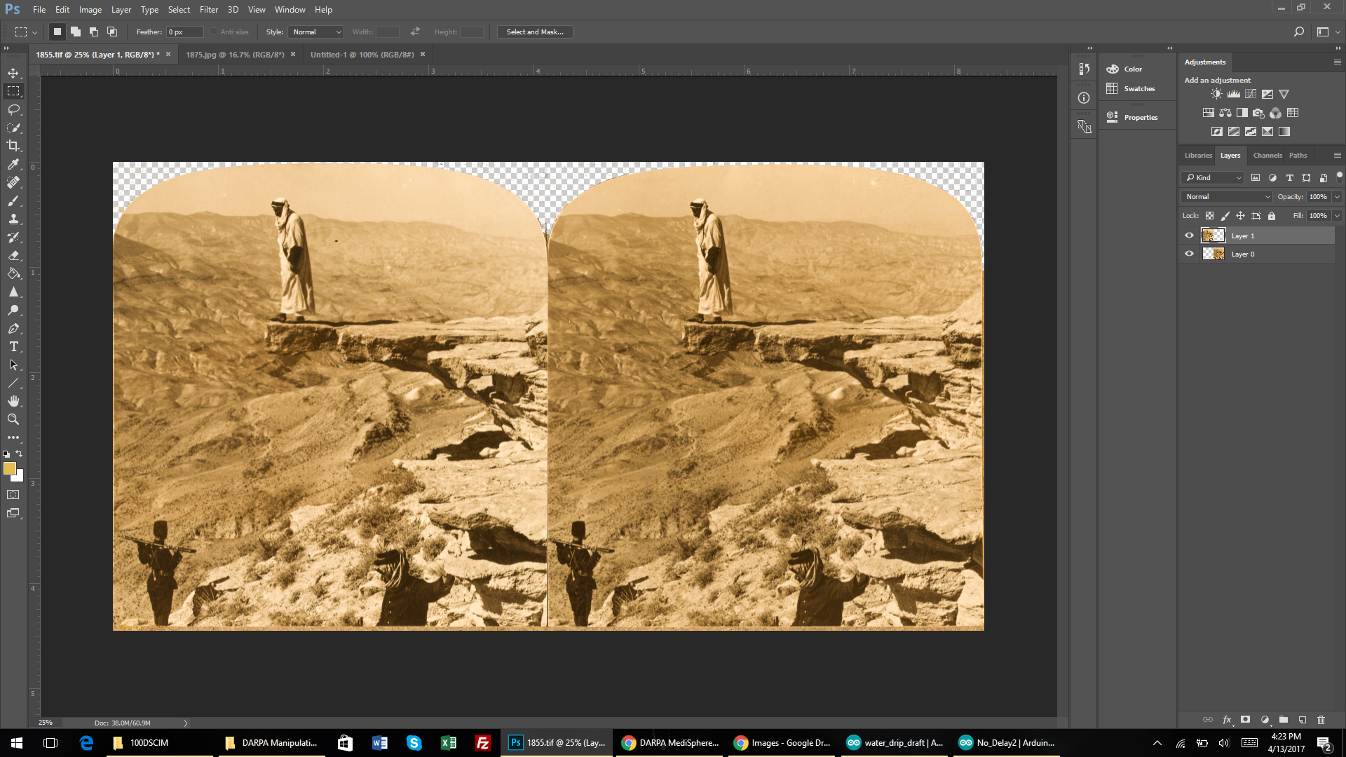
The image is now in two separate layers

Slide 11
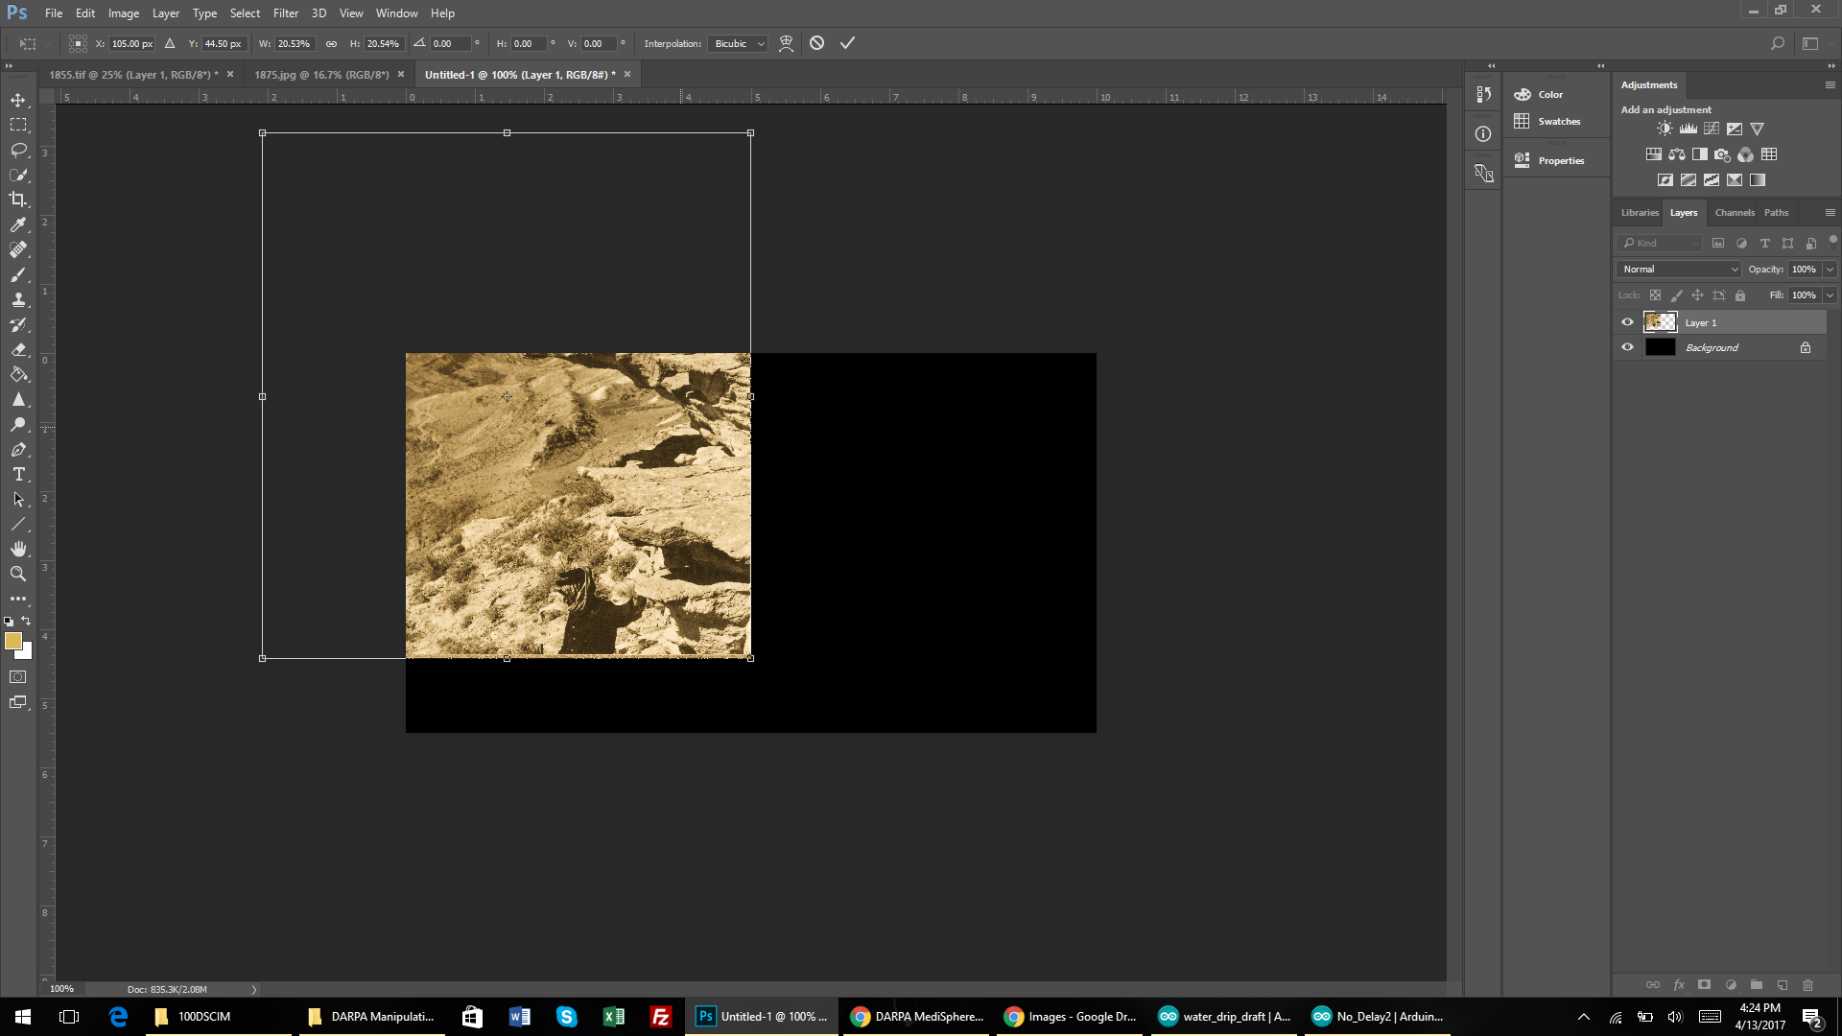
Move the first image to the new background

Slide 12
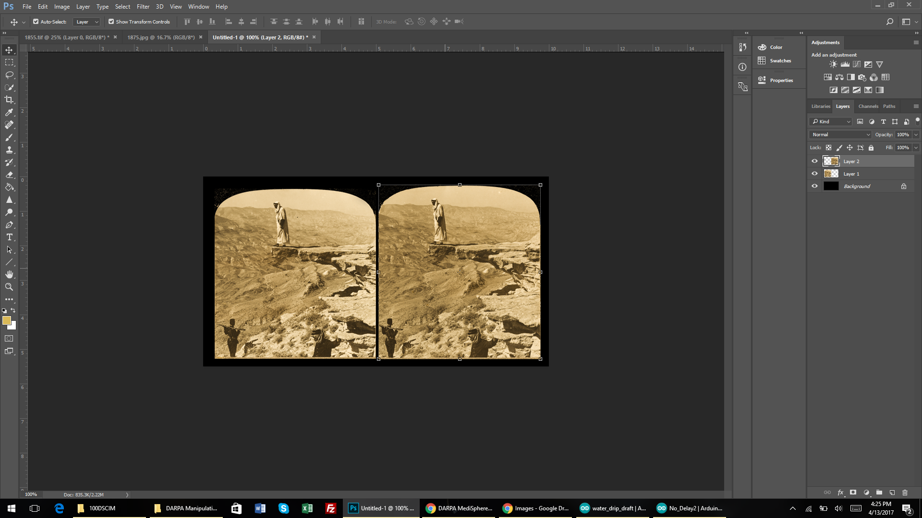
Move the other selection and resize both images to fit in the frame

Slide 13
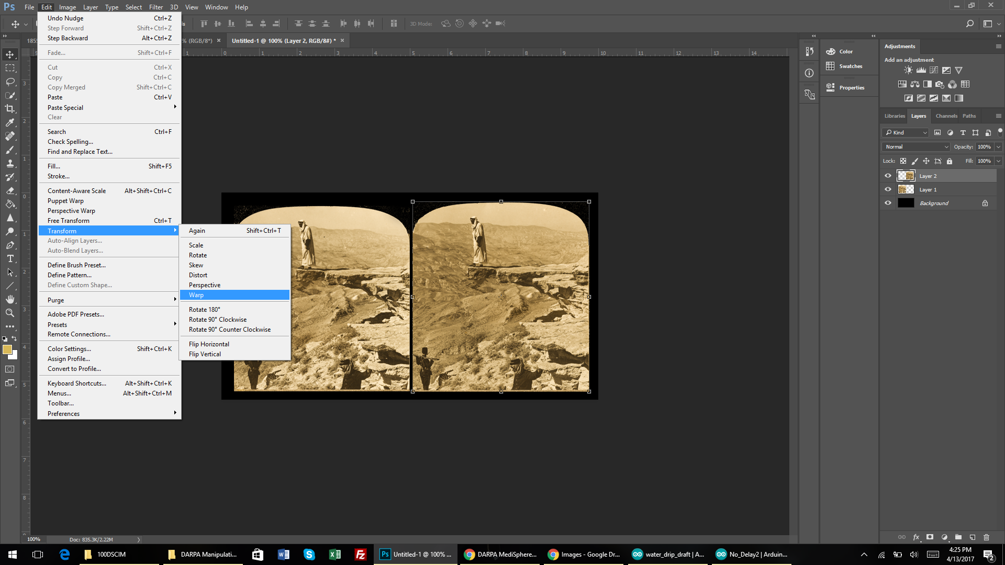
Select on of the images and go to the warp tool

Slide 14
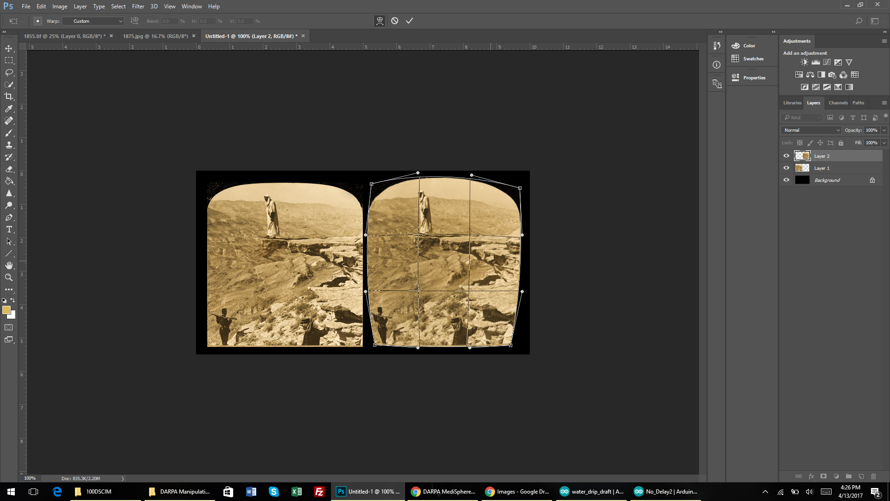
To correct for spherical lenses warp the images to give them a bit of distortion, which will be corrected when viewed through lens.

Slide 15
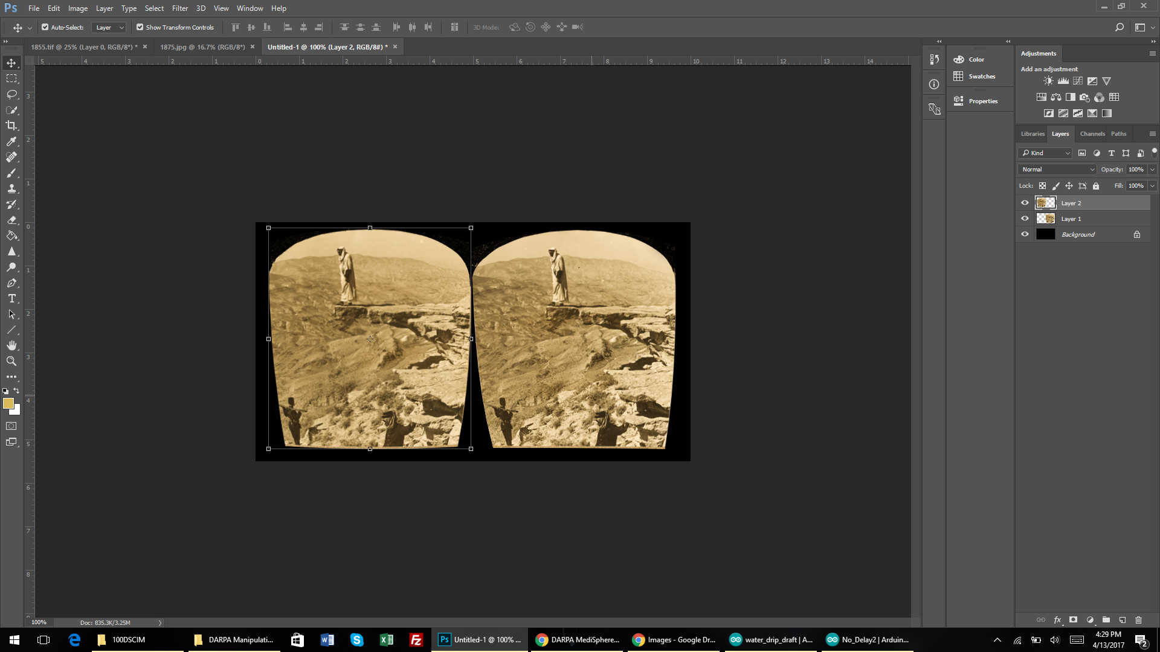
Repeat the process with the second image, try and make the distortion similar for each.

Slide 16
Exporting
Right click on layers and flatten image
Save as jpeg

